Slide 1
Video Tutorial on Max Peak, Min Peak, and AC Video Detectors of the FSWT
This is the PowerPoint file that accompanies the video.
Please watch the video for a more detailed and thorough explanation.
The video is available at https://screencast-o-matic.com/watch/cYl0I98JnG
Harry W. Gaul, PE, CTP Level II
harry@tabargaul.com
December 7th, 2020
Copyright Notice: All material is copyright 2020 by Gaul TEMPEST Consulting Services.
Notes:
Notes level one
Notes level two
Notes level three
Notes level four

Slide 2
Introduction
The FSWT includes various detectors that can be used when performing automated scans in frequency. This includes Max Peak, Min Peak, AC Video (Pulse), and AC Video (Sine) as well as Average and RMS.
EMI tests use the Max Peak Detector because the peak emission levels are what usually cause interference among devices.
But TEMPEST is more concerned with the modulation present on the carrier because the modulation is what conveys the message signal.
This training video will do a deep dive into the mathematics of the Amplitude Modulation equation. This is important in order to understand how the various detectors work within the FSWT.
The basic recommendation is to use the AC Video (Pulse) detector when doing an automated TEMPEST scan. We will demonstrate why on the following slides.
Notes:
Notes level one
Notes level two
Notes level three
Notes level four

Slide 3
Amplitude Modulation Equation (Part One)
Let’s define the equation of a carrier wave to be:
Let’s define the equation of the message signal, i.e., the modulation signal to be:
The equation for Double Sideband Amplitude Modulation (DSAM) of the carrier signal by the message signal is given by:
and rearranging terms:
Let’s define
as the Mod Index, thus
At this point, we could take the V(t) equation and plot it in Excel. But before we do that, let’s expand the terms and use a trig identity.
Notes:
Notes level one
Notes level two
Notes level three
Notes level four

Slide 4
Amplitude Modulation Equation (Part Two)
From the previous slide:
Let’s expand the terms:
We will use the trig identity:
This yields:
Expand the terms:
Carrier term Lower Sideband Term Upper Sideband Term
Notes:
Notes level one
Notes level two
Notes level three
Notes level four

Slide 5
Amplitude Modulation Equation (Part Three)
Spectrum Analyzer Display of Double Sideband Amplitude Modulation
If we set A_{c} to be 1 volt and the Mod Index, M, to be 0.3 (i.e., 30% AM), then the peak carrier level = 1 volt and each sideband = 0.15 volt.
20*log(0.15/1) = -16.48 dBc In other words, each sideband is 16.48 dB below the carrier.
This can be readily seen on a spectrum analyzer assuming that the IF bandwidth is set reasonably small compared to f_{m}, say about 1/10th.
When the two sidebands are summed together, their amplitude is added coherently to a value that is 6 dB higher than either sideband.
6 dB + -16.48 dBc = -10.48 dBc, which is very close to the -10 dB correction factor that we add to the carrier level when signal substituting with 30% AM.
Notes:
Notes level one
Notes level two
Notes level three
Notes level four

Slide 6
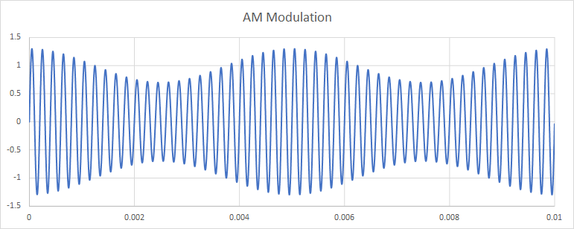
Amplitude Modulation Equation (Part Four)
Let’s view the Double Sideband Amplitude Modulation in the Time Domain
Assume the dwell time of the receiver is set to 0.01 seconds.
The FSWT Max Peak detector will find the maximum level of the envelope during that dwell time period.
The FSWT Min Peak detector will find the minimum level of the envelope during that dwell time period.
The AC Video (Sine) detector correctly measures the 30% AM modulation to be 0.3 volts.
Notes:
Notes level one
Notes level two
Notes level three
Notes level four

Slide 7
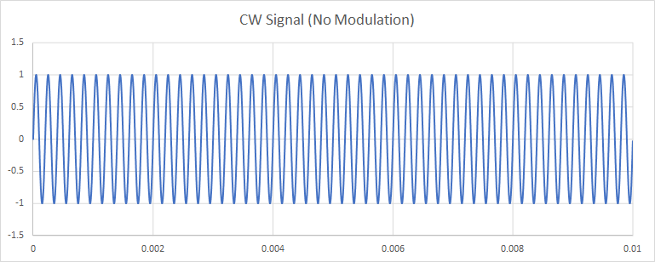
Amplitude Modulation Equation (Part Five)
CW Signal in the Time Domain
* Note: because of noise present on the envelope, the AC Video (Pulse) won’t be exactly zero but instead will equal the peak-to-peak noise plus any residual AM on the CW signal.
We can measure the carrier level of the CW signal using the Max Peak detector, but it doesn’t tell us anything about the modulation if present.
The AC Video (Pulse) or AC Video (Sine) measures the modulation and in this case, both AC Video readings will be approximately zero*.
TEMPEST is not concerned with the level of the carrier, but rather with any modulation on the carrier because the message signal is conveyed by the modulation. Therefore, the AC Video detectors are useful when performing automated scans.
Notes:
Notes level one
Notes level two
Notes level three
Notes level four

Slide 8
Amplitude Modulation Equation (Part Six)
The AC Video (Pulse) detector will display a reading 6 dB higher than the AC Video (Sine) detector because of the factor of 2 in the denominator of the AC Video (Sine) equation.
So which detector should we use when doing automated scans?
We typically do signal substitution by matching the zero-to-peak of the of the substitution sinewave (e.g., 1 kHz AM at 30%) to the zero-to-peak of the correlation as shown below.
Max Peak = 2 V
AC Video (Pulse) = 2 V – 0 V
= 2 V
Min Peak = 0 V
Signal Substitution Yields 2 V
Envelope of IF
(i.e., video)
Therefore, we should use the AC Video (Pulse) detector to be consistent with the signal substitution technique.
Note: noisy signals are more accurately measured with signal substitution than with the AC Video (Pulse).
Notes:
Notes level one
Notes level two
Notes level three
Notes level four

Slide 9
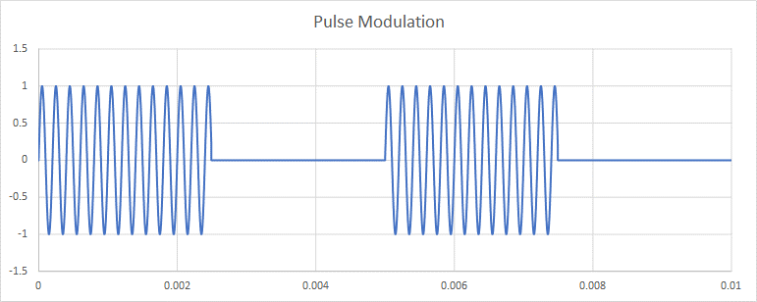
Amplitude Modulation Equation (Part Seven)
Also, in the case of pulse modulation where the carrier is pulsed on and off, the AC Video (Pulse) detector is the more appropriate detector.
Shown below is pulse modulation with an on/off carrier and its associated video envelope.
In this case, Max Peak – Min Peak = A_{c} = 1 V
Furthermore, signal substitution will yield the same value when the zero-to-peak of the modulating sinewave matches the zero-to-peak of the envelope.
Notes:
Notes level one
Notes level two
Notes level three
Notes level four

Slide 10
Amplitude Modulation Equation (Part Eight)
As mentioned previously, the AC Video (Pulse) detector will accurately measure noise-free signals.
But what happens when we measure a relatively noisy signal?
Max Peak = 0.94 V
AC Video (Pulse) = 0.94 V – (-0.33) V
= 1.27 V
Min Peak = -0.33 V
Signal Substitution Yields 0.6 V
Envelope of IF
(i.e., video)
In this specific case of a noisy signal, the AC Video (Pulse) detector reads more than 6 dB higher than signal substitution. The reason is that the detector is measuring both signal and peak-to-peak noise.
Notes:
Notes level one
Notes level two
Notes level three
Notes level four

Slide 11
Conclusions
The Max Peak Detector is appropriate for EMI tests where we want to measure the peaks of the carriers.
But when doing automated TEMPEST scans, we really want to measure the amount of the modulation present since that is related to the message signal. We can do that with the AC Video detector.
The AC Video (Pulse) detector will give a reading more consistent with the way we do signal substitution for TEMPEST measurements.
The AC Video detector measures both signal and peak-to-peak noise, thus providing a worst-case reading. The signal substitution method provides a more accurate method for measuring just the signal.
Hopefully, this short tutorial on 30% AM and the various detectors within the FSWT has given you a better understanding of the measurement process.
Notes:
Notes level one
Notes level two
Notes level three
Notes level four

