Slide 1
Video Rastering Techniques
8/25/2019 Rev. B
Harry W. Gaul, CTPII
Gaul TEMPEST Consulting Services LLC
harry@tabargaul.com
480-223-7368

Slide 2
Dutch Computer Researcher: Wim van Eck
In a 1985 paper, van Eck demonstrated that the screen content of a video display unit could be reconstructed at a distance by using low-cost home built equipment: a TV set whose sync pulse generators were replaced by manually controlled oscillators.
Originally found on CRT devices, but virtually all displays including LCD/LED flat panels and video signals on video cables can be rastered.
The repetitive signals can be heavily averaged to improve the S/N ratio (although it can be tricky to synchronize the frames.)
S/N improvement for 100 frames of a steady image:
10*log(100 frames) = 20 dB

Slide 3
Example of Re-Rastering of Radiated Emissions from a Display

Slide 4
Readability as a Function of S/N

Slide 5
Raster Scan of an Electron Beam in a Cathode Ray Tube (CRT)
Legend

Slide 6
VGA Timing, 640 x 480 @ 60 Hz
Three separate lines (RGB) on the VGA cable carry the analog color levels. The voltage varies between 0V and 0.7V. 0V corresponds to completely dark and 0.7V corresponds to maximum brightness.
While the cabling interface is analog, the VGA signal starts out as 8 bit binary digital. The digital signal is processed through a D/A converter on the video board prior to being transmitted over the VGA cable.
In the “old days”, a CRT would use the analog signals to illuminate RGB phosphors on the CRT screen. Magnetic deflection coils were used to position the electron beam on the screen.
In today’s modern monitors, the analog VGA signal is converted back to digital with an A/D. The digital signal is then processed to illuminate LCD screens.
Today’s monitors can also accept various digital signals directly over their cable interfaces without the need for the signal to be processed with D/A and A/D converters. These digital signals include DVI, HDMI, Displayport, and others.
640 active pixels
25.42 μs
26.06 μs
29.87 μs
31.78 μs
HSR = 1/31.78 us = 31.47 kHz
480 active lines
15.253 ms
15.571 ms
15.634 ms
16.683 ms
1/16.683 ms = 59.94 Hz

Slide 7
VGA Timing, 640 x 480 @ 60 Hz
This frequency is needed for the software program to average the signal.
60 frames per second (actually 59.9405 Hz)
Horizontal Scan Rate (HSR) = 59.9405 Hz * 525 lines = 31.46875 kHz
Rd_{pixel} = Pixel Clock = 59.9405 Hz * 800 * 525 = 25.175 MHz
This frequency is needed for the software program to raster the signal.
Rd_{row} = 40*HSR = 40 * 31.46875 kHz = 1.25875 MHz
Rt = ? I usually assume that the rise and fall times are about 1/10th of the pixel clock. That makes Rt = Rd_{pixel} so no additional test is needed for Rt.
800 total horizontal pixels per line
525 total lines per frame
From http://www.tinyvga.com/vga-timing

Slide 8
Typical Video Monitor Rates
Video Mode | Active Area Format | Horizontal Scan Rate (HSR)
VGA | 640x480 @ 59.94 Hz | 31,468 Hz
SVGA | 800x600 @ 60 Hz | 37,680 Hz
720P | 1280x720 @ 60 Hz | 45,000 Hz
XGA | 1024x768 @ 60 Hz | 48,360 Hz
SXGA | 1280x1024 @ 60 Hz | 63,960 Hz
1080P, Full HD, HDMI | 1920x1080 @ 60 Hz | 67,500 Hz
The Horizontal Scan Rate shown in this table is only approximate because the total number of lines varies from manufacturer to manufacturer. The exception is 1080P video mode because of the standardization by industry. Most of today’s monitors support 1080P and will upconvert lower resolutions such as VGA to 1080P.

Slide 9
Overall Test Approach
Bandwidths are selected based on normal rules for
Rd_{row}
Rd_{pixel}
Rt
The optimized bandwidth is typically 5 to 10 times Rd_{row}
Special hardware and/or software is needed to raster the video output of the receiver.
A large “E” is a common test pattern, although it may not be the best.
The Gaul TEMPEST simulator has 4 patterns to select which direction the “E” faces: up, down, left right.
An option is now available for the FSWT to perform video rastering using the FSWT display (option K57 is about $27k).

Slide 10
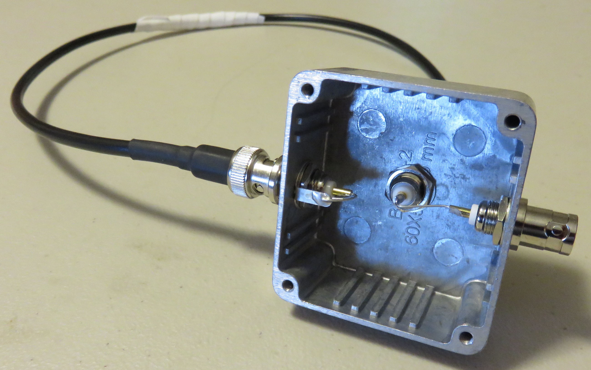
Single Turn Shielded Magnetic Loop
24” RG58 coaxial cable with ¼” section of shield removed
Center pins connected together
To
RCVR
Center pin soldered to grounded ring tab
I have used this loop for frequencies from DC to 1.5 GHz.

Slide 11
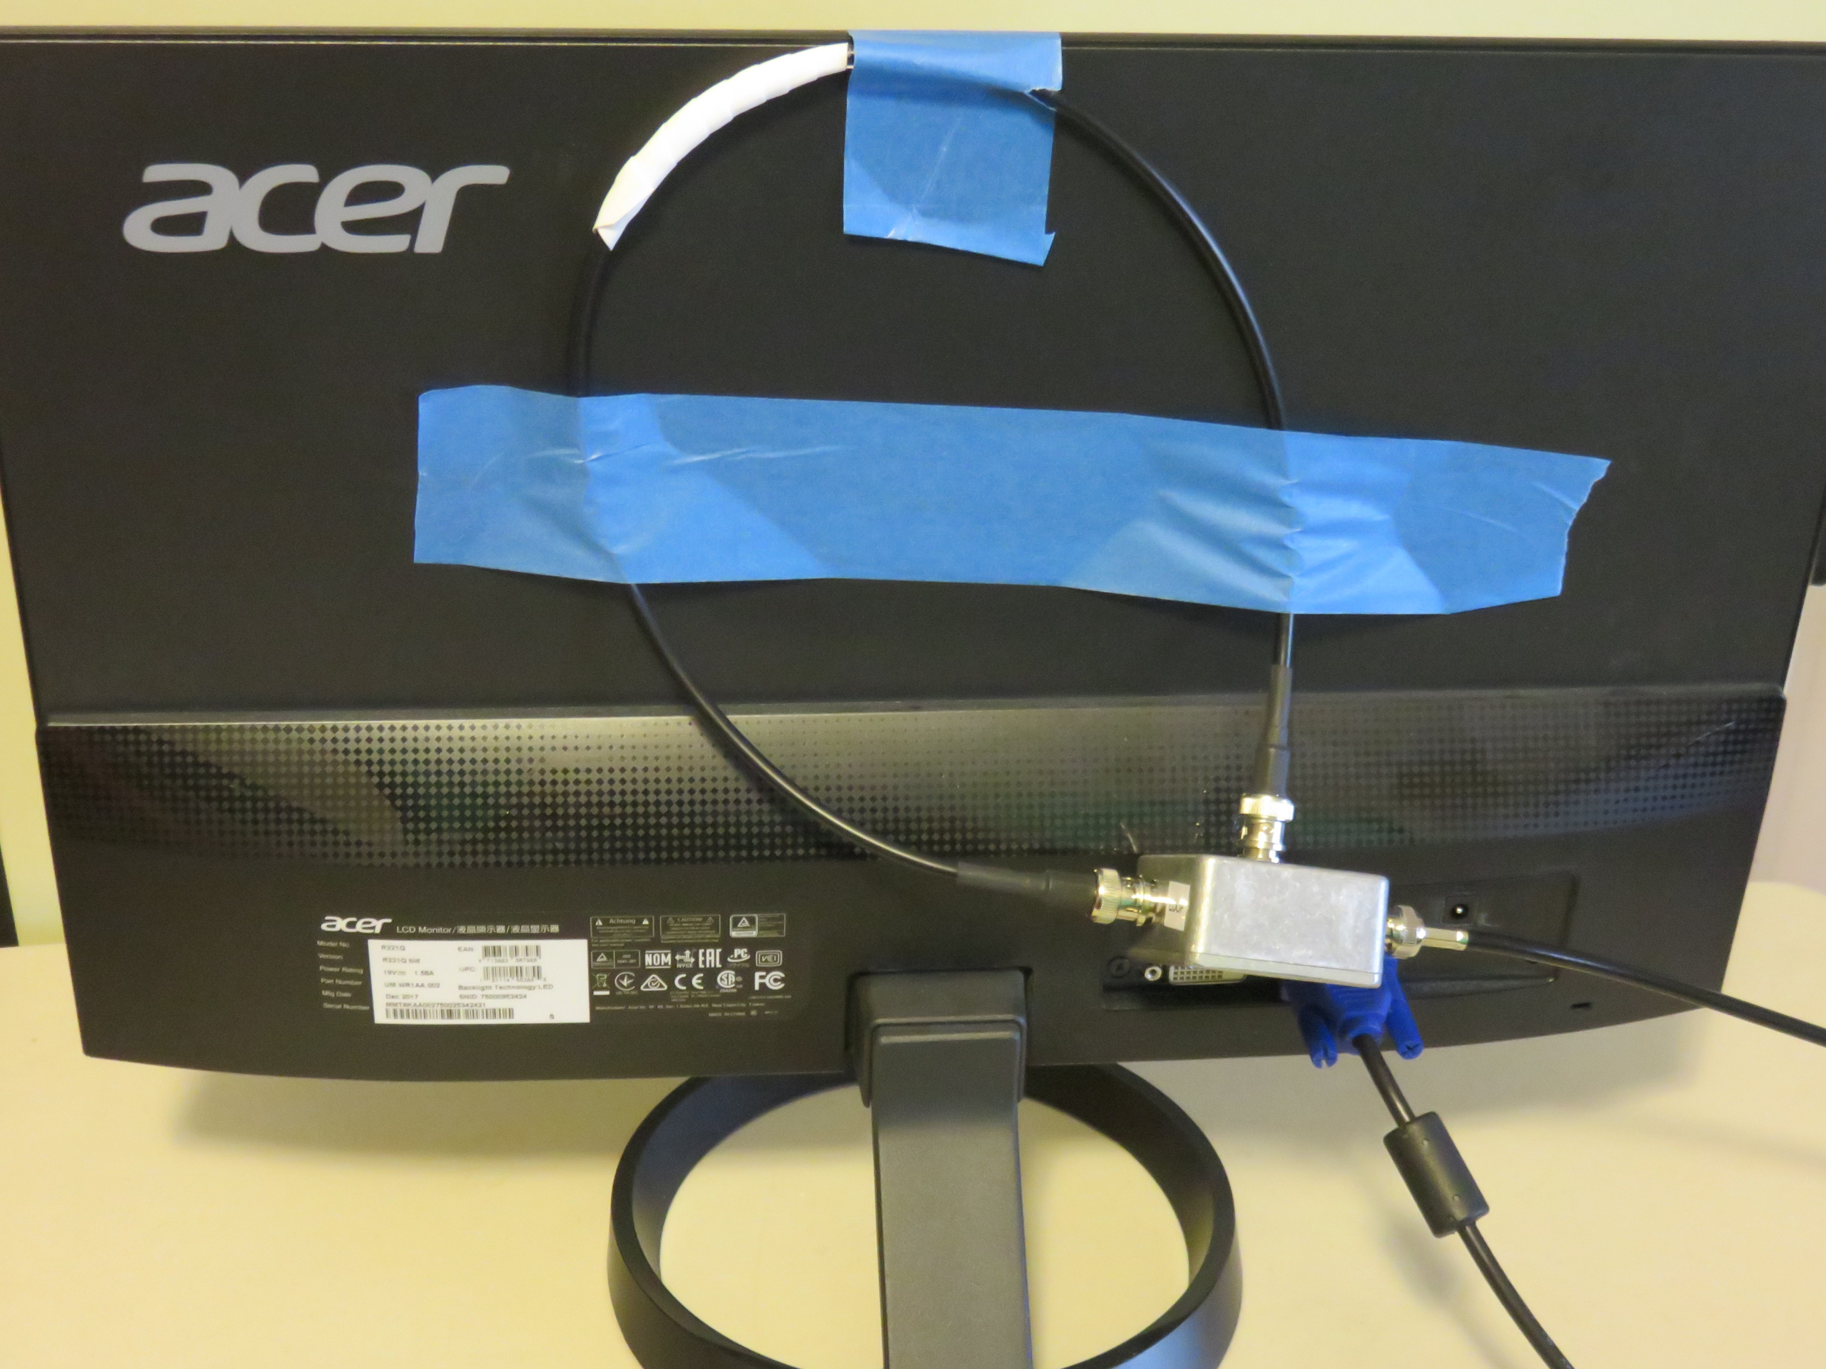
Initial Placement of Magnetic Loop
Magnetic loop taped to back of monitor
To
RCVR

Slide 12
Suggested Test Patterns Based on My Initial Investigation*
Alternate between these two images at once per second in PowerPoint
White text on a 50% black background
50% black text on a white background
*
My initial investigation found that black-and-white was not nearly as good as 50% gray-and-white.

Slide 14
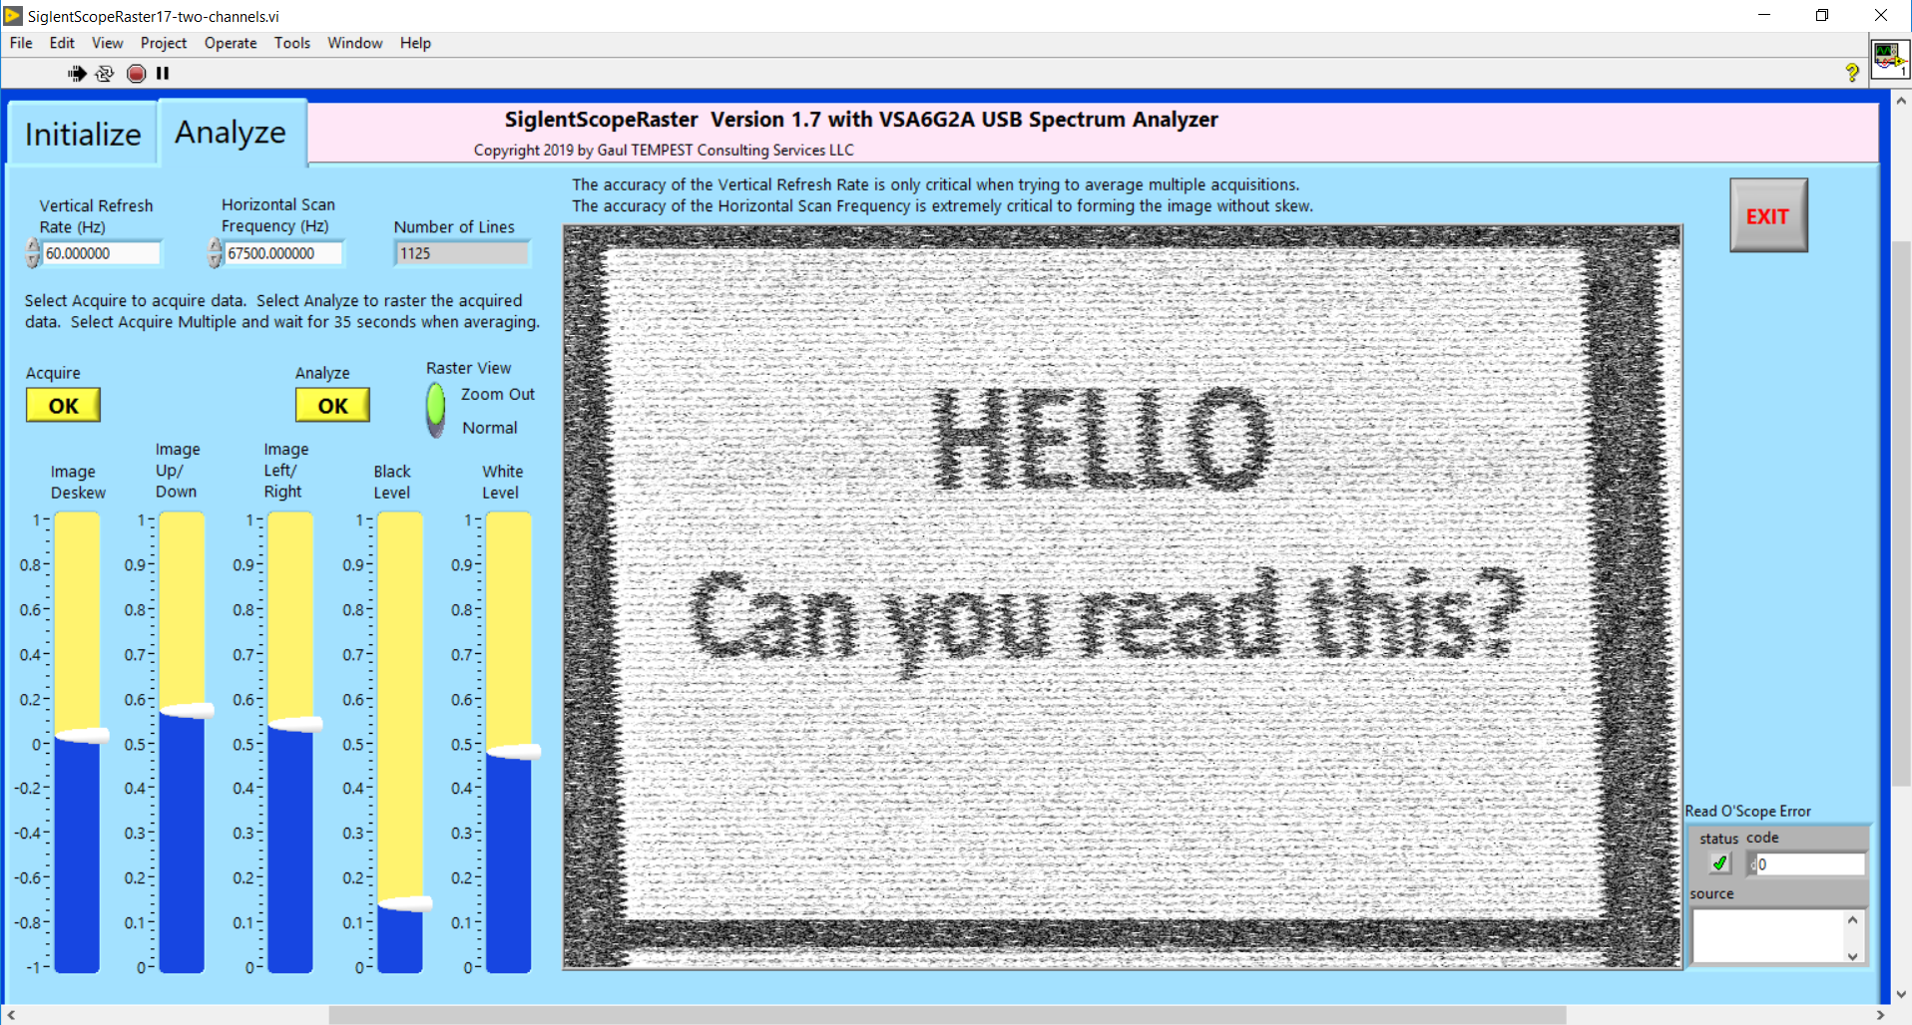
Re-Rastered 1080P Signal, White Text on 50% Gray Background
The vertical refresh rate is only critical when averaging frames.
The horizontal scan frequency is critical to raster an image without skew. The frequency must be within +/- 1% in order for the Image Deskew slider to work.
Acer Monitor with one turn magnetic loop. Tuning frequency is 276.3 MHz with the VSG6G2A USB Spectrum Analyzer bandwidth of 10,090 kHz and span of 1 MHz. Reference level is -50 dBm. Scope channels are set to 50 mV/division.

Slide 15
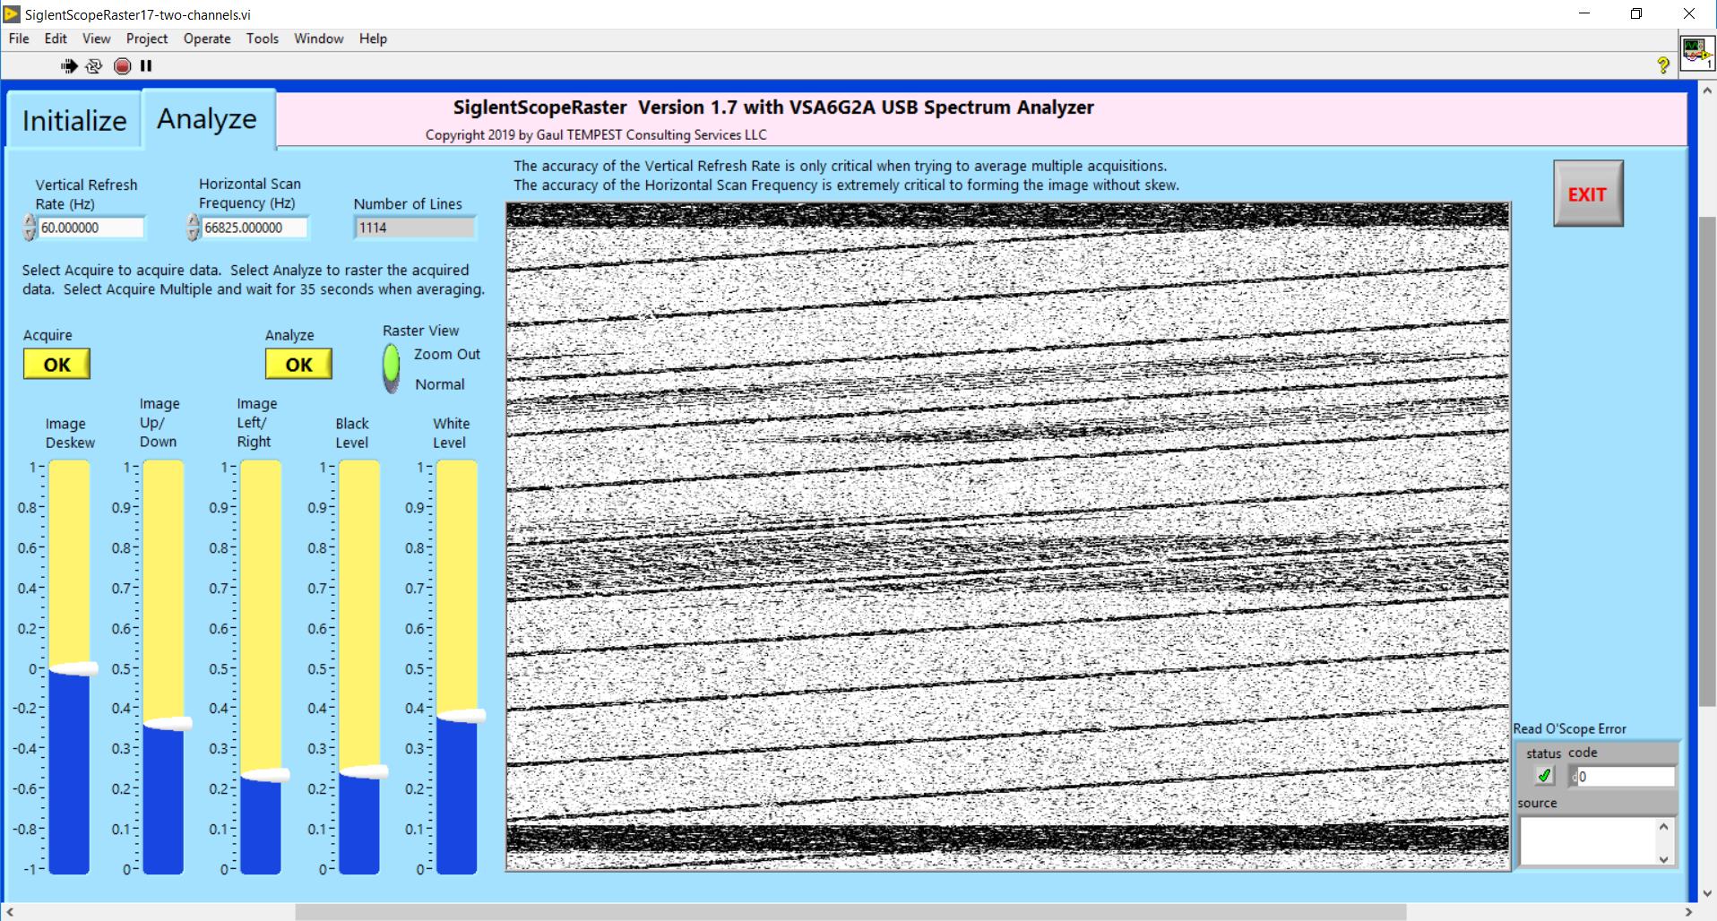
Same as Before but with 1% Timing Skew in the HSR
In this example, the horizontal scan frequency is set to 1% less than 67,500 Hz.
Observe the characteristic slanting (or skewing) of the video image.
Acer Monitor with one turn magnetic loop. Tuning frequency is 276.3 MHz with the VSG6G2A USB Spectrum Analyzer bandwidth of 10,090 kHz and span of 1 MHz. Reference level is -50 dBm. Scope channels are set to 50 mV/division.

Slide 16
A Little Background on RGB Formats
Emissions from modern displays typically come from the digital bit pattern on cables and video interface boards.
VGA emanations are typically created by the A/D process or upsampling after the A/D in the monitor and are related to the digital bit pattern, not the analog pattern.
DVI/HDMI/Displayport emanations are typically from the digital signals on the cable themselves or in the processing of those signals in the monitor.
As such, the bit pattern of the RGB data is important.
Each of the Red, Green, and Blue (RGB) signals contain serial data.
8 bits/byte for VGA signals with levels from 0 to 255 (decimal).
10 bits/byte for DVI/HDMI signals because of 8b/10b encoding of the same levels from 0 to 255 (decimal). The 8b/10b is TMDS (not the usual 8b/10b algorithm used for 1000Base-T.)
Because the 3 signal lines (RGB) are in parallel, we want the same serial signal to be present on each of the 3 lines. Thus, we typically want to send black, white, or gray colors.
Note that there are 256 x 256 x 256 = 16.7 million colors available.

Slide 17
There are 256 Shades of Gray from 0x0x0 (Black) to 255x255x255 (White)
Custom VGA
15x15x15
0000 1111
White
255x255x255
1111 1111
White
Darker 5%
242x242x242
1111 0010
Black
Lighter 50%
127x127x127
0111 1111
Custom VGA
240x240x240
1111 0000
Black
0x0x0
0000 0000
White
Darker 15%
217x217x217
1101 1001
Black
Lighter 35%
89x89x89
0101 1001
Custom DVI
164x164x164
1010 0100
0011 1000 11
Custom DVI
170x170x170
1010 1010
1100 1100 10
White
Darker 25%
191x191x191
1011 1111
Black
Lighter 25%
64x64x64
0100 0000
After my initial work with 50% gray, I decided to try various shades of gray to see if I could find something even better.
Note how White and Black do not have any transitions in their bit pattern.
Custom DVI
85x85x85
0101 0101
1100 1100 01
Black
Lighter 15%
38x38x38
0010 0110
White
Darker 35%
166x166x166
10100110
Custom DVI
33x33x33
0010 0001
1100 0001 11
Black
Lighter 5%
13x13x13
0000 1101
White
Darker 50%
127x127x127
0111 1111

Slide 18
VGA Signal to Acer Monitor over VGA Cable
Emanation Rastered at 67.5 kHz Suggesting the Emanation is Related to 1080P
Tuning Frequency was 276.3 MHz and Bandwidth was 10 MHz
50% Gray
White
Black
170x170x170
1010 1010
1100 1100 10
85x85x85
0101 0101
1100 1100 01
White Background

Slide 19
Laptop that has Only VGA Capability (1366x768 Resolution)
50% Gray
White
Black
170x170x170
1010 1010
1100 1100 10
85x85x85
0101 0101
1100 1100 01
White Background

Slide 20
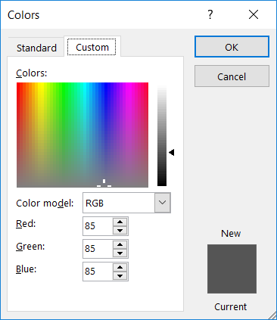
New Test Pattern to Create Highest Contrast Between No Transitions (White) and Maximum Transitions
85 Text on White
170 Text on White
217 Text on White VGA
64 Text on White DVI

Slide 21
New Test Pattern to Create Highest Contrast Between No Transitions (White) and Maximum Transitions
85 Text on White
170 Text on White
217 Text on White VGA
64 Text on White DVI

Slide 22
Laptop with VGA Only 1366 x 768, HSR = 46,806 Hz.
With New Test Pattern
Rastered Image
Test Pattern
64 Text on White (Invisible)
64x64x64
0100 0000

Slide 23
Laptop VGA at 800x600, uses same 46,806 Hz HSR as used for 1366x768, 4th line is 64 text on White DVI.
The laptop’s native image size is 1366x768. The 800x600 is upsampled to 1366x768.

Slide 24
VGA Signal to Acer Monitor over VGA Cable.
Tuning Frequency of 1236 MHz and 10 MHz BW.
Emanation is presumed to be the 10-bit 1080P (DVI/HDMI) as opposed to the 8-bit VGA because the 64x64x64 text is rasterable.
Rastered Image
Test Pattern

Slide 25
Suggested Approach for Determining Vertical Refresh Rate
Place a single turn loop on back of monitor and route the coax to a scope channel terminated in 50 ohms.
Display a single PowerPoint image.
Adjust the scope timebase to 2 ms per division.
Trigger the scope from a square wave signal generator with frequency adjusted for the expected vertical refresh rate (typically 60 Hz).
Measure the frame width with the cursors and observe the frequency.
Adjust the signal generator frequency to synchronize the pattern on the scope.
It may be useful to reduce the timebase setting to about 10 us per division and fine tune the signal generator frequency as much as possible.

Slide 26
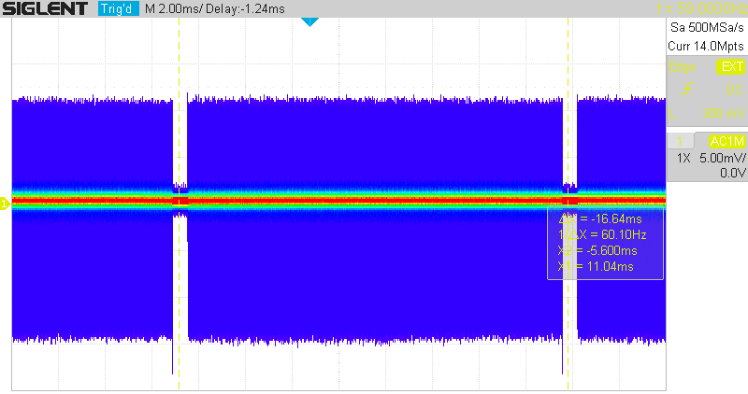
Scope Display for Finding the Vertical Refresh Rate
The scope is adjusted for 2 ms per division. The sample rate is maximized to ensure adequate bandwidth (500 MSa/s in this example).
The cursors show a Vertical Refresh Rate of about 60.1 Hz. This can be fine-tuned by decreasing the timebase setting while adjusting the frequency on the signal generator to eliminate drift of the video signal.

Slide 27
Suggested Approach for Determining Horizontal Scan Rate (HSR)
While using the previous setup, change the scope timebase to 10 ms per division.
Trigger the scope as before.
Turn on the MATH channel and select FFT.
Using the cursor, locate the HSR frequency. It should be near the expected HSR based on the monitor resolution.
If no spectral line is observed near the expected HSR frequency, then try looking at 2*HSR frequency.
Enter the HSR frequency into the raster software program.

Slide 28
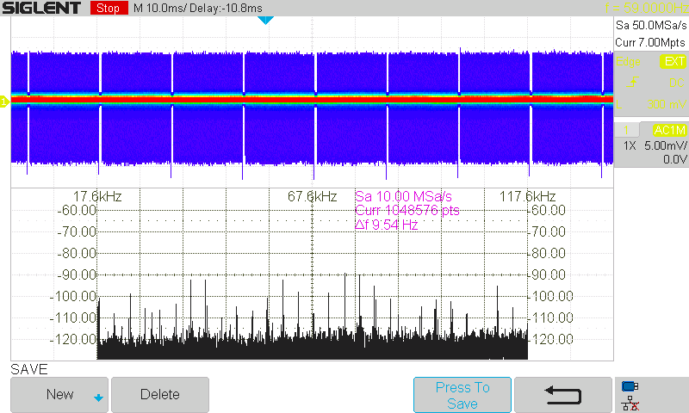
FFT Display for Horizontal Scan Rate with a 1080P Monitor (HSR = 67.5 kHz)
~ 67.5 kHz

Slide 29
FFT Display for Horizontal Scan Rate with a 1080P Monitor (2*HSR = 135 kHz)
~ 2*67.5 kHz = 135 kHz

Slide 30
Next Step: Find Actual Correlation and Fine Tune the HSR
Place single turn loop on back of monitor and route the coax to a TEMPEST Receiver.
Connect the video output of the receiver to the scope.
Adjust the scope timebase to 2 ms per division.
Trigger the scope as before.
Use a test pattern that toggles between two patterns.
Tune the receiver while observing the scope for correlation to the video frame.
When suspected correlation is found, use the raster program to raster the video signal for Pattern1. Fine tune the HSR frequency as necessary to deskew the image.
Search the entire frequency range with the single turn loop and make a list of tuned frequencies where correlation is found.
You are now prepared to perform the actual TEMPEST test in various media while paying attention to the list of tuned frequencies where correlation was found.
Pattern 1 Pattern 2 (all white)

Slide 31
R&S FSWT Rastering Option K57
As you might expect, the FSWT rastering option K57 is significantly more sophisticated than my little LabView program with a $350 scope.
K57 has ability to automatically determine best settings for vertical and horizontal scan rates.
K57 provides ability to average the signal.
The algorithm is significantly more complex than one would think because of the need to be very precise in aligning frames prior to averaging.
Open literature suggests need to perform autocorrelation of each frame data to find the starting point of each frame.
K57 software runs on the FSWT and uses the FSWT display.
No need to run rastering software on a PC.
Very fast processing since the data does not have to be transferred to a PC.
K57 can use coloring as opposed to gray scale to highlight differences in the rastered image, although my personal preference is gray scale.

Slide 32
K57 Rastering Demo
We will use my ATES Simulator to create a signal to detect and raster.
Change 64 Hz to 60 Hz. The HSR will be 512 rows * 60 Hz = 30.72 kHz.
40*HSR = 1.23 MHz 512 pixels/row * 512 rows * 60 Hz = 15.7 MHz pixel clock

Slide 33
K57 Rastering Demo: Overview
Rastering is an application separate from the other applications such as Spectrum or Receiver.
Rastering has its own Overview Menu

Slide 34
Initial Steps for K57 Rastering Demo
Prior to using the Rastering application, one needs to find a frequency with the suspected correlation using the Receiver application with an oscilloscope and an alternating video test pattern. Then we need to use two other applications (Spectrum and Analog Demod) to find the vertical refresh rate and horizontal scan frequency.
Press Setup, Parameter Coupling, Center Frequency: On. (Very important so that all applications use same frequency).
Set the center frequency to 150 MHz (i.e., the carrier frequency of the raster signal).
Using the spectrum analyzer display, observe the spectrum.
Press Mode, Spectrum2, Span, 0 Hz (we are going to find the vertical refresh rate).
Press Sweep, Sweep Time: Manual, 40 ms.
Use markers to find the vertical refresh rate. The inverse of the delta marker time should be about 60 Hz.
Press Mode, Analog Demod (we are now going to find the horizontal scan frequency).
Set Meas Time to 50 ms.
Press Display Configuration, drag the AM Spectrum onto display area.
Set AF Start to 0 Hz and AF Stop to 100 kHz (we are essentially displaying an FFT of the 50 ms acquisition).
Use the Marker to find the line rate (i.e., horizontal scan rate), which should be 30.72 kHz.
Calculate the number of lines by dividing the line rate by the vertical refresh rate (30,720/60 = 512 lines/frame).
Go to next slide to activate the Rastering application.

Slide 35
Activate the Rastering Application
Press Mode, Rastering (i.e. activate the rastering application).
Press Overview, Rastering, Lines per Frame, 512. Line Rate 30.72 kHz (the lines are not as critical as the line rate).
Press Overview, Trigger, Time Trigger, 16.6667 ms (i.e., 1/60).
Note: instead of using Time Trigger, one can also try Overview, Rastering, Locking = On.
Press Overview, Rastering, Image Stabilization = On (stabilizes horizontal scan rate).
Press Overview, Rastering, Data Acquisition, Sample Rate to increase the sampling rate which will sharpen the image.
Press Meas Config, De-Skew, and draw a line with the mouse in the angle of the tilt to deskew the image. Deskewing basically adjusts the line rate to align the image.
Press Overview. Rastering, Scaling, and use either Auto-Range or Cutoff High / Cutoff Low to adjust the contrast of the image.

Slide 36
K57 Rastering Demo: Closing Thoughts
The FSWT User’s Manual has in-depth information on using the raster option.
There are various ways to trigger the acquisition and to automatically find the vertical refresh rate and horizontal scan frequency.
I have demonstrated the “manual” approach since I tend to be old school and want to understand the what and why of what I am doing.
My previous experience with the K57 rastering software was on a beta version with limited features. So I suggest spending some serious “tinkering” time with all the features to fully understand all the capabilities.

