Slide 1
How to Use InterpolateDataSheet.XLSM
Harry W. Gaul, PE, CTP-II
2/27/2017
Note: please be sure to view this presentation in Slide Show mode. This will enable the embedded videos to run upon mouse clicking or paging down. Even more importantly, the videos will be displayed by using your entire computer screen.

Slide 2
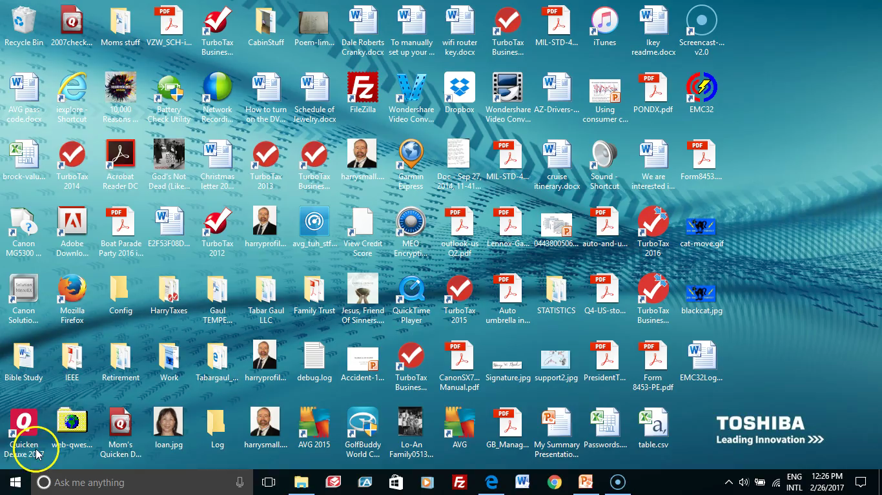
Overview
InterpolateDataSheet.xlsm is a macro-based Excel file. It can be used to:
  Create a standardized TEMPEST Report Data Sheet.
  Interpolate TEMPEST limits after the various TEMPEST limits of NSTISSAM/TEMPEST/1-92 have been entered.
  Interpolate transducer values such as Antenna Correction Factors (ACF) and LISN factors.
  Interpolate cable loss attenuation values.
  Calculate the value of manually measured correlated emanations (CE or DRE) by including all of the relevant correction factors.
By using InterpolateDataSheet.xlsm, one can reduce math errors in calculations while creating report-ready data sheets.
Overview
Video

Slide 3
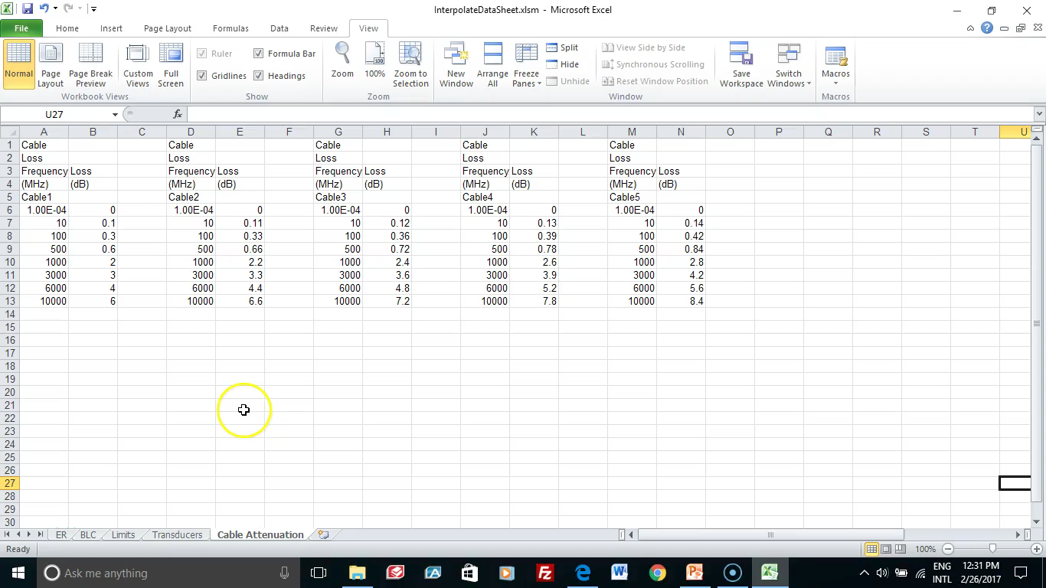
Cable Attenuation and the Use of Name Manager
The Cable Attenuation tab is used for storing the cable loss. A cable loss is entered as a positive number.
The Name Manager is used for defining the range of cells associated with the values of cable loss.
  The name “Cable” contains the numerical values of frequency in MHz and loss in dB.
  The name “Cable_No” contains the cable designator such as Cable1, Cable2, etc.
  The macros use these names to interpolate the cable loss as a function of frequency and cable designator.
Typically, EMC32 is used to initially create the cable loss values by controlling a signal generator and power meter.
Video of Cable Attenuation and Name Manager

Slide 4
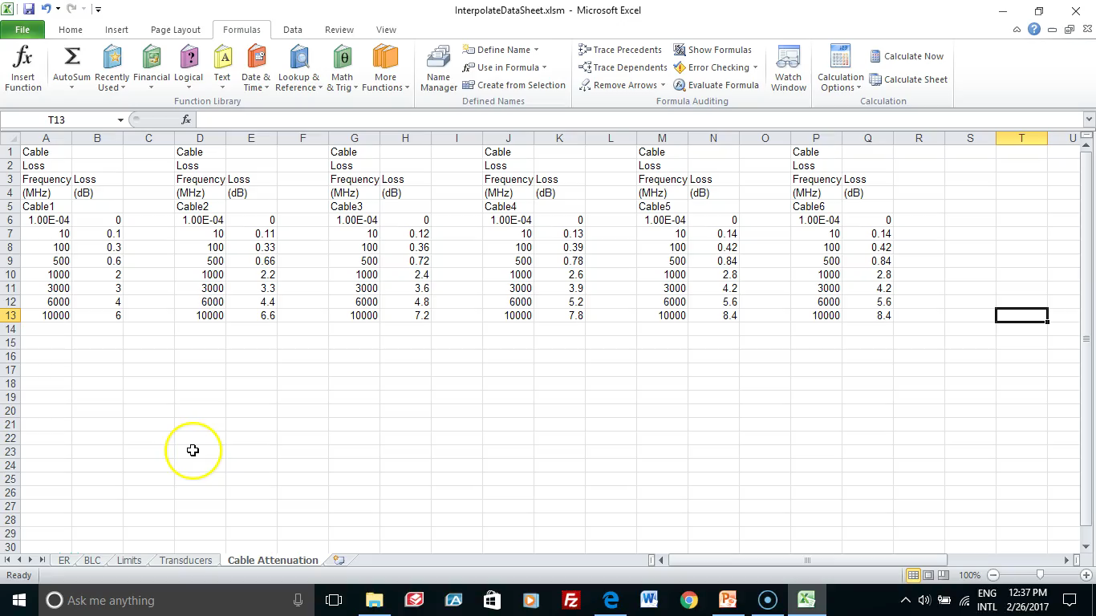
Transducers
Transducer values are stored in the Transducer worksheet.
Transducers include Antenna Correction Factors and LISN Insertion Loss Factors.
The Name Manager is used for defining the range of cells associated with the Transducer factors.
  The name “Transducer” contains the numerical values of frequency in MHz and correction factor in dB.
  The name “Transducer_No” contains the Transducer designator such as SAS2A, Bicon, etc.
  The macros use these names to interpolate the transducer factor as a function of frequency and transducer designator.
Video of Transducers worksheet

Slide 5
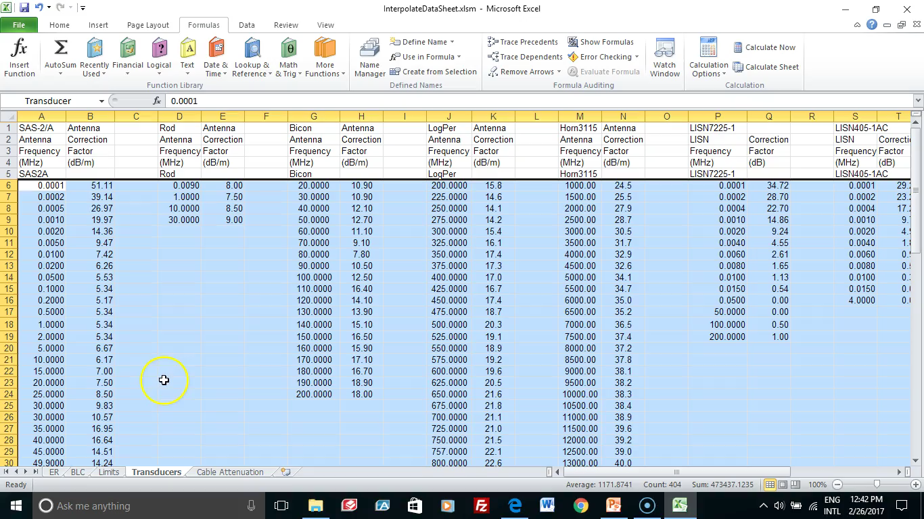
Limits
Limits are stored in the Limits worksheet.
  The limits currently included are merely examples and need to be replaced with the actual limits from NSTISSAM TEMPEST/1-92.
  Once updated, the InterpolateDataSheet file will become classified.
The Name Manager is used for defining the range of cells associated with the Limits.
  The name “Limit” contains the numerical values of frequency in MHz and limit (dBuV/m for ER and dBuV for BLC).
  The name “Limit_No” contains the shorthand designator for the limit such as ERIIB for ER, Level II, Category B.
  The macros use these names to interpolate the limit as a function of frequency and limit designator.
Video of Limits worksheet

Slide 6
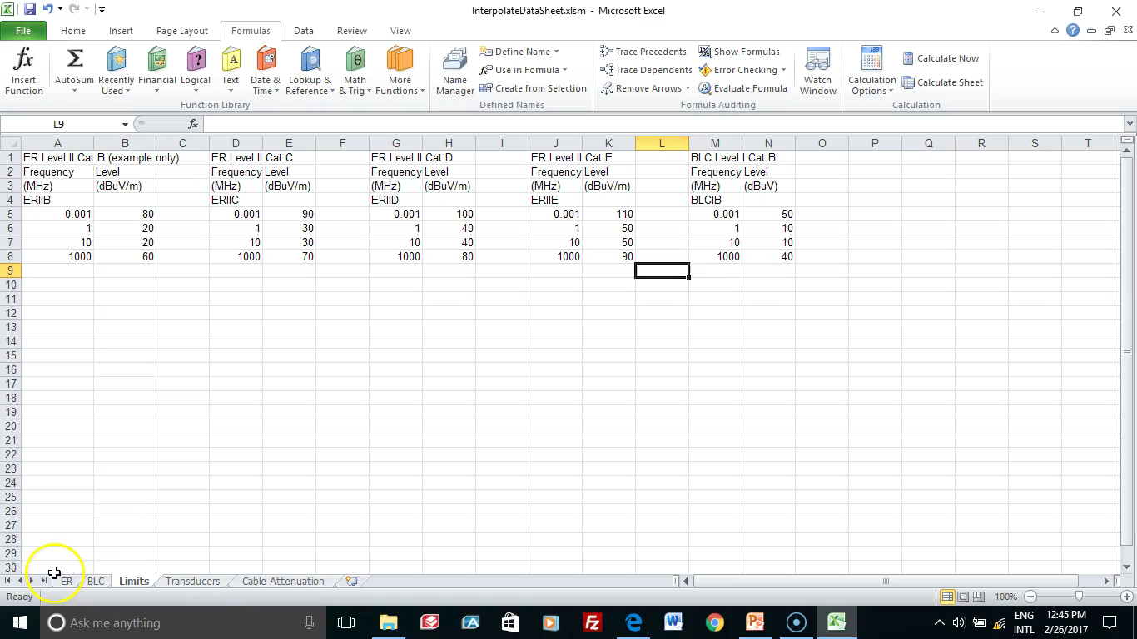
ER
A generic ER data sheet is located in the ER worksheet.
When viewed in Page Layout mode, one can see the header and footer that can be edited to indicate the classification level of the data sheet.
Switching back to View, Normal, one can see the following.
  The first 5 rows contain header information. The Signal Class must be entered correctly in cell F5 so that the limit can be correctly calculated.
  The Table of CE and DRE are populated with the signal generator levels found during signal substitution with 30% AM.
  The optimized bandwidth is also entered although it is not used in any of the calculations.
  The designators for Transducer, Test Limit, and Cable are entered into columns K,L, and M for each instance of CE and/or DRE found.
  If the test is a combined Rd/Rt test, then be sure to enter the correct test limit designator in Column L depending on whether the data point falls into the lower category or higher category.
Video of ER worksheet

Slide 7
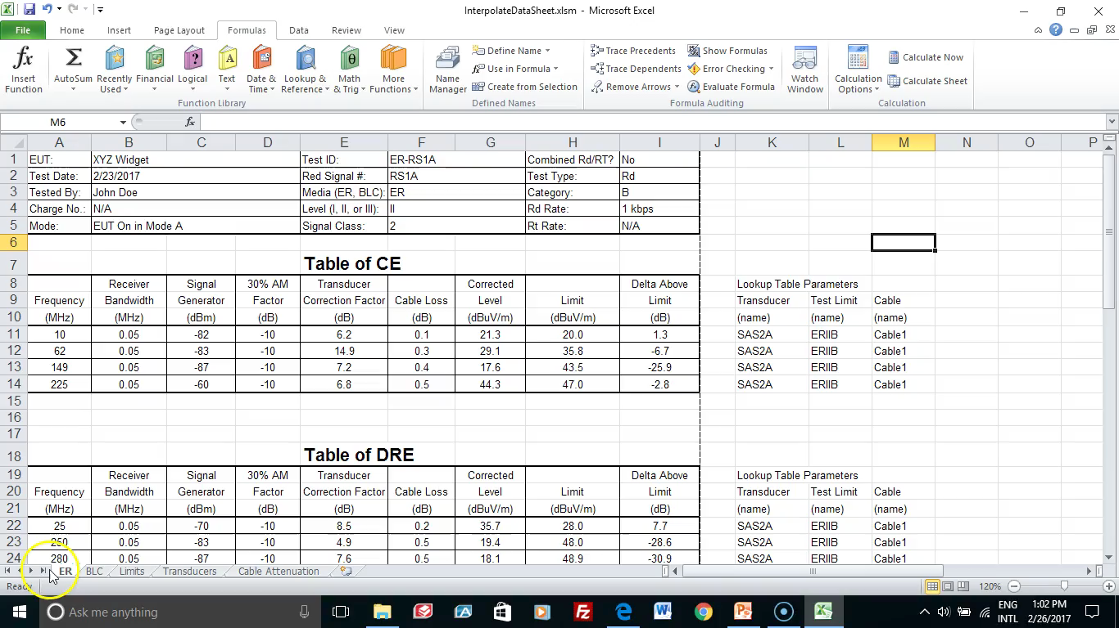
BLC
A generic BLC data sheet is located in the BLC worksheet.
The BLC worksheet is nearly identical to the ER worksheet except that the limits and corrected levels are in dBuV instead of dBuV/m.
Note also that the Transducer in Column K and Limit in Column L correspond to BLC tests.
Each test performed by the TEMPEST Engineer should have its own worksheet. Additional worksheets can be added to the InterpolateDataSheet file by right-clicking on the ER (or BLC) tab and selecting Move or Copy, and checking the Create a Copy box, and then clicking on OK.
Video of BLC worksheet and how to create a copy of the worksheet

Slide 8
Adding a Plot of Test Data
The manual data obtained with the InterpolateDataSheet.xlsm can be copied-and-pasted into an EMC32 Table so that the manual data points can be plotted along with the automated data.
Once the graph is created within EMC32, it is saved as a Windows Meta File (WMF) graphical image.
There is a blank space shown by the black cat picture at the bottom of both ER and BLC worksheets where one can paste the graphs created within the EMC32 software.
The next slide shows a video of inserting the WMF file.
Once inserted, you will now have a report-ready data sheet.

Slide 9
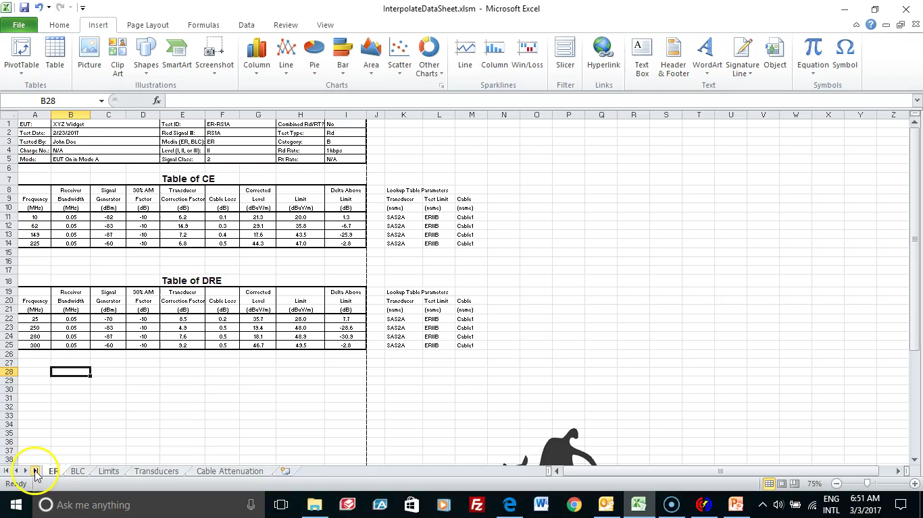
Inserting WMF Graphic File Into Excel
The WMF graphic file is stored in a subdirectory located at C:\ProgramData\EMC32\Tests\XYZ\ER_1Mbps_Rd\Graphics
The filename is ER_1Mbps.wmf
Within Excel, click on Insert, then Picture and browse to find the file.
Click on the file to highlight it and then click on Insert.
After inserting the picture, right click on it and select Size and Properties. Ensure that the Scale says a Height of 100% and a Width of 100%. If necessary, adjust these parameters to 100%.
The goal is for the picture to be inserted at 100% in order to maximize the resolution of the graphic.
If the picture does not fit the area in the spreadsheet at 100%, then it will be necessary to modify the graphic dimensions within EMC32 by clicking on Extras, Options, Graphics and trying other dimensions for width and height.
Inserting WMF
Into Excel Data Sheet

Slide 10
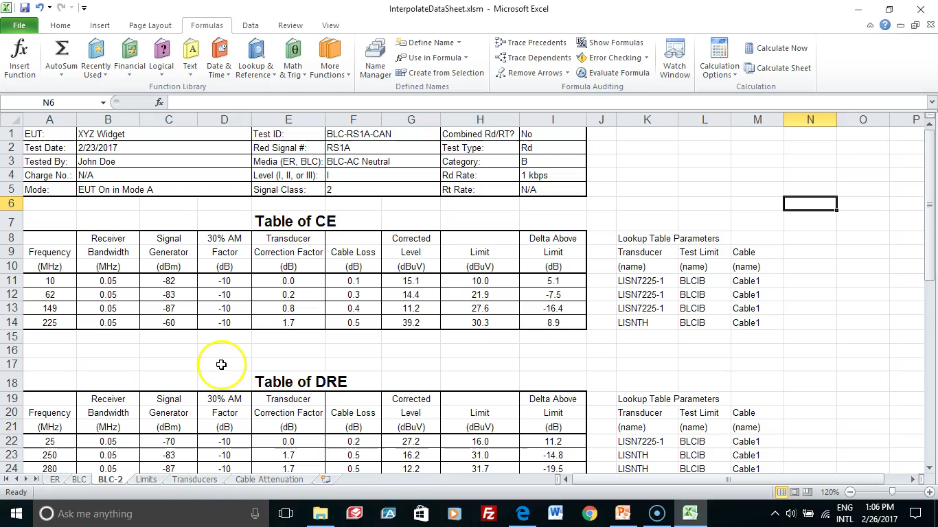
Advanced Material on Macros
This slide can be skipped unless you are curious about the macros used in InterpolateDataSheet.xlsm.
The macros were programmed using Visual BASIC Script (VBS).
To see the macros, click on View, Macros.
Then in the box, type log_inter and click on Edit.
The log_inter function has three arguments:
  log_inter(freq, col_num, my_array)
  Where freq is the frequency
  col_num is the designator to find the correct table of values
  my_array is the table of values
  Do not edit anything! Simply click the red X in the upper right hand corner to exit the macro editor.
There is also a lin_inter macro that is not used in this Excel file but may be useful in certain situations. It performs linear interpolation instead of logarithmic interpolation.
Video of Macros

