Slide 1
How to Calibrate Cables with EMC32
Harry W. Gaul, PE, CTP-II
March 4th, 2017
Note: please be sure to view this presentation in Slide Show mode. This will enable the embedded videos to run upon mouse clicking or paging down. Even more importantly, the videos will be displayed by using your entire computer screen.

Slide 2
Cable Calibration Concept
The approach to calibrating the loss of a cable is to make two measurements:
  The 1st measurement is the “Normalization” scan. It is done without the cable-under-test.
  The 2nd measurement is the “Calibration” scan. It is done by adding the cable-under-test to the Normalization test setup without removing anything.
  The difference in dB levels between the two scans is the cable loss.
  Remember that EMC32 uses positive numbers for cable loss.
Normalization Setup
Calibration Setup
Signal Generator
Power Meter
Signal Generator
Power Meter
Short
Cable
Short
Cable
Cable-Under-Test

Slide 3
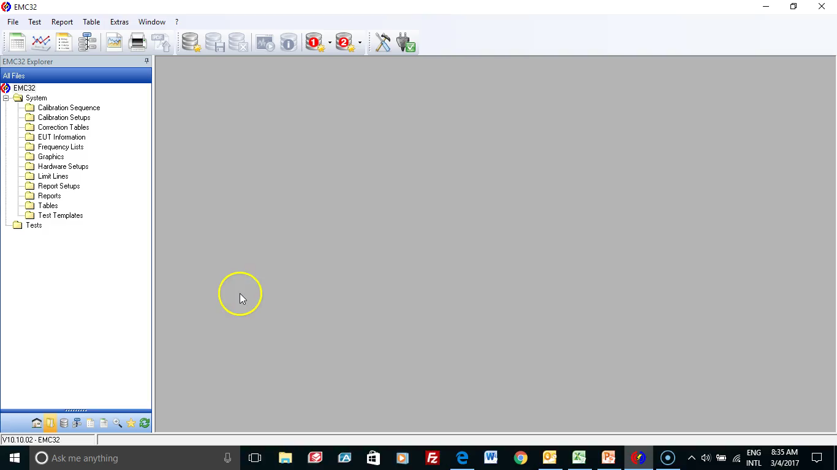
Device List
Prior to running the cable calibration, we need to first make sure the power meter and signal generator are properly configured in the device list in EMC32.
  Double click on NRP-Zxx in the device list. Choose NRP-Z51 if you are in demo (virtual) mode.
  Double click on SMB100A in the device list. Choose SMB-B140 if you are in demo (virtual) mode.
  If you are using the iKey and connected to an actual signal generator and power meter, then choose the appropriate option that matches the equipment.
Device List for Cable Calibration

Slide 4
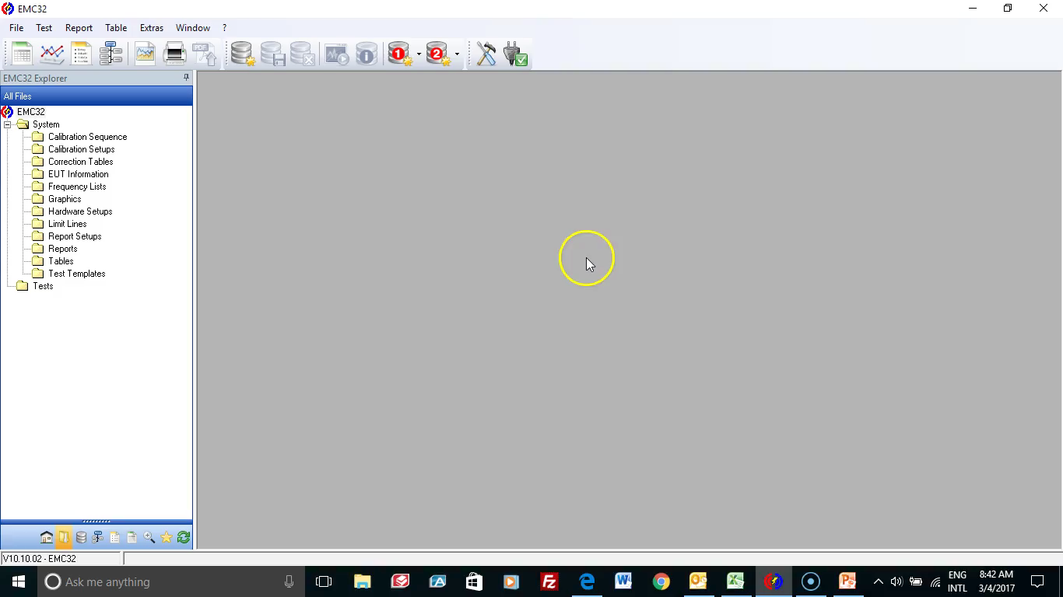
Calibration Setups
Use EMC32 Explorer, All Files, and select Calibration Setups.
Right click, select new and follow the prompts.
After the cable has been calibrated, use the Table icon to edit the cable table.
You will need to insert a row at the top of table with a frequency of 100 Hz and a loss of 0 dB.
Calibration Setups

