Slide 1
How to Calibrate Cables with ELEKTRA
Harry W. Gaul, PE, CTP-II
December 18th, 2020
Note: please be sure to view this presentation in Slide Show mode. This will enable the embedded videos to run upon mouse clicking or paging down. Even more importantly, the videos will be displayed by using your entire computer screen.

Slide 2
Cable Calibration Concept
The approach to calibrating the loss of a cable is to make two measurements:
  The 1st measurement is the “Normalization” scan. It is done without the cable-under-test.
  The 2nd measurement is the “Calibration” scan. It is done by adding the cable-under-test to the Normalization test setup without removing anything.
  The difference in dB levels between the two scans is the cable loss.
  Remember that ELEKTRA uses positive numbers for cable loss.
Normalization Setup
Calibration Setup
Signal Generator
Power Meter
Signal Generator
Power Meter
Short
Cable
Short
Cable
Cable-Under-Test

Slide 3
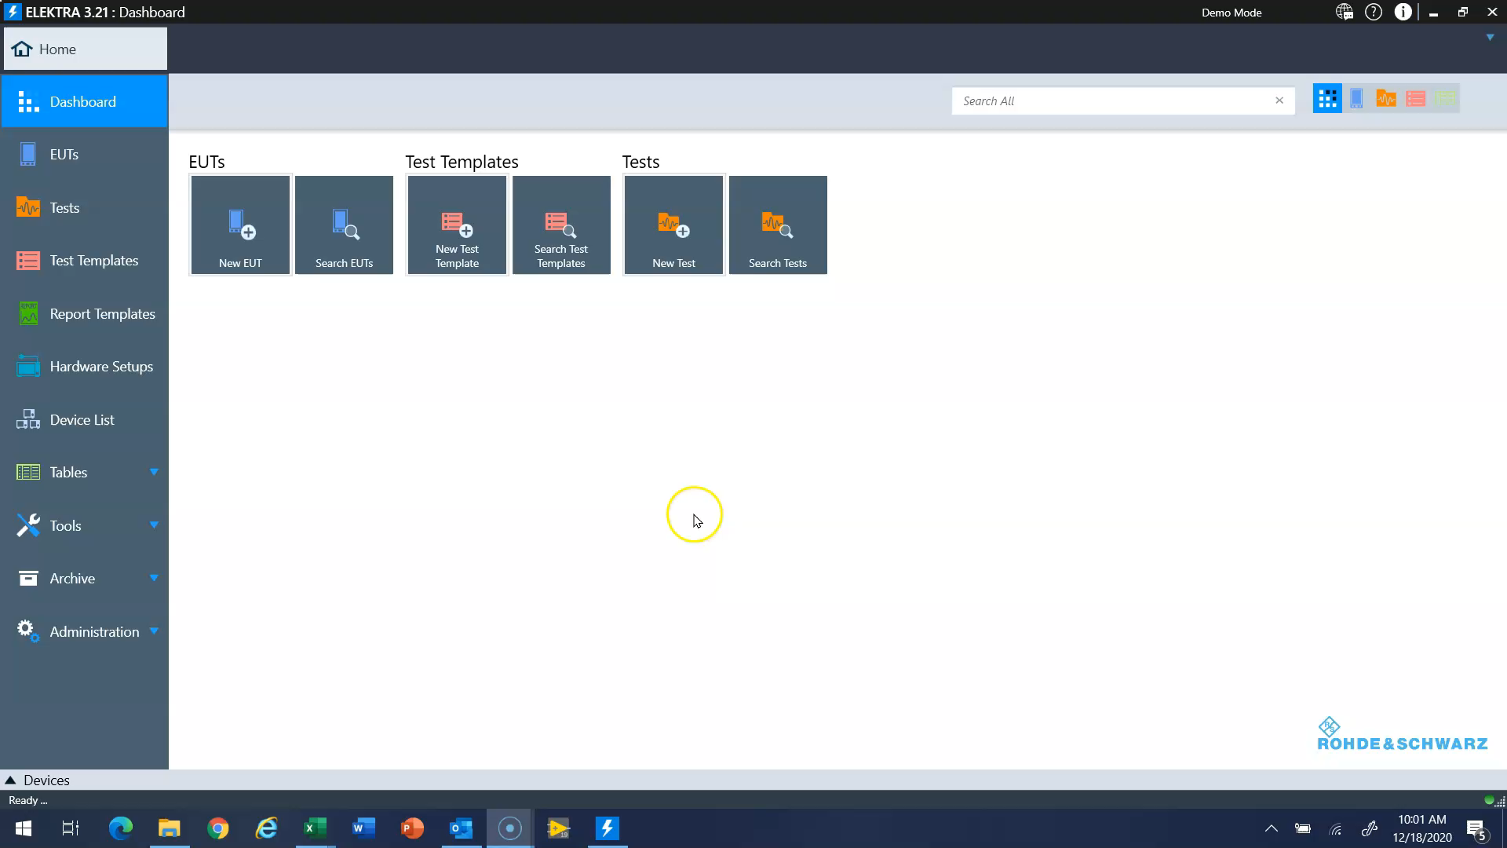
Device List and Test Templates
Prior to running the cable calibration, we need to first make sure the power meter and signal generator are added to the Device List in ELEKTRA.
We do not need to create a Hardware Setup.
We then use Test Templates to Create a CAL template to do the cable calibration.
Watch the video on this slide by clicking the mouse or hitting Page Down on your keyboard.
Cable Calibration Video

